Slide 1
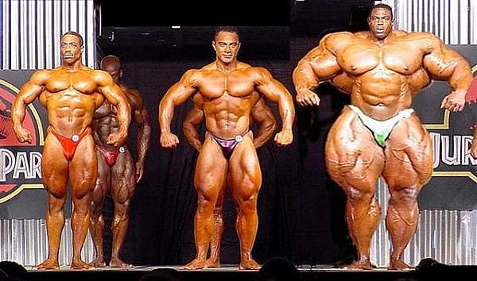
Chapter 8 Muscles
Pages: 178-184

Slide 2
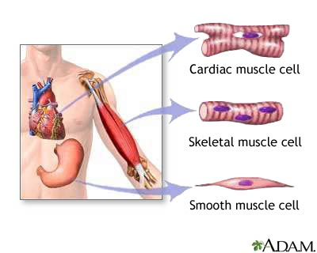
Introduction
Muscles are made up of three types of tissues:
Skeletal (focus of chapter)
Smooth
Cardiac

Slide 3
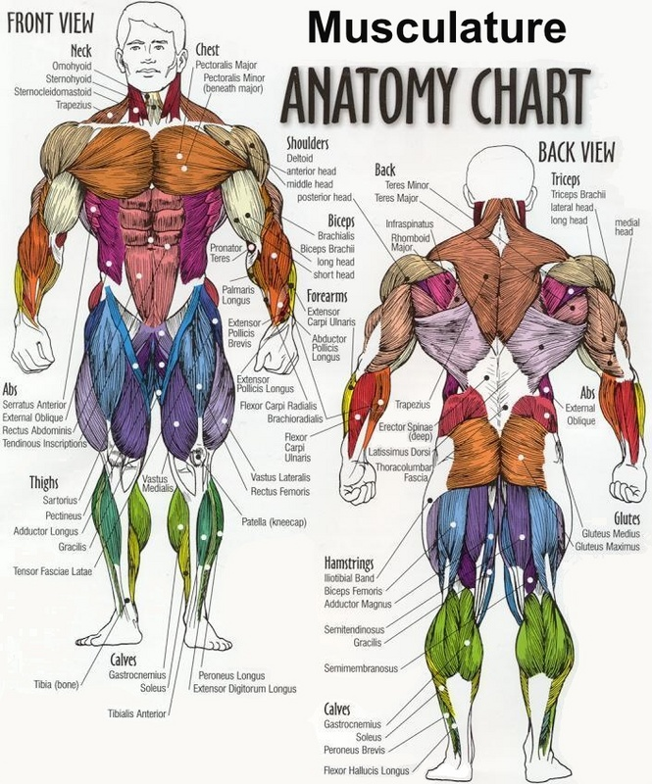
Structure of a Skeletal Muscle
Muscular System is made up of:
Individual muscles (organs)
Which are made up of
Skeletal muscle tissue
Nervous tissue
Blood
Connective tissue

Slide 4
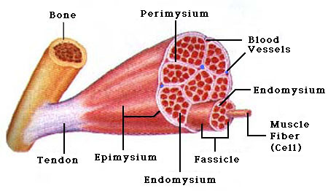
Connective Tissue Coverings
Fascia:
Separate an individual skeletal muscle from adjacent muscles and hold it in position
Tendon:
Cordlike fascia that extends beyond end of muscle and attaches bone to muscle
Aponeuroses:
Sheetlike covering that attaches muscle to muscle

Slide 5
Connective Tissue Coverings Cont.
Epimysium
Layer of connective tissue that surrounds a skeletal muscle
Perimysium
Extends inward from epimysium to separate muscle tissue into small compartments
Fascicles:
Bundles of skeletal muscle fibers
Endomysium:
Covers individual muscle fibers

Slide 6
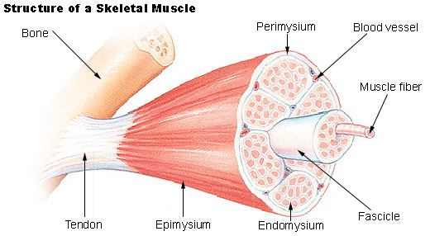

Slide 7
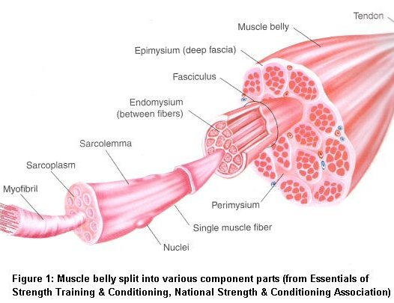
Skeletal Muscle Fibers
Each fiber is a single muscle cell that contracts in response to a stimulation and then relaxes when stimulation ends.

Slide 8
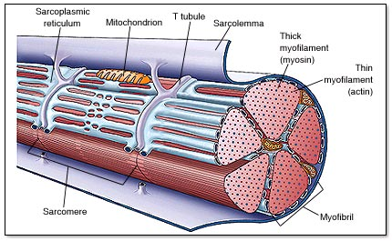
Skeletal Muscle Fibers Cont.
Thin elongated cylinder with rounded ends that extends length of muscle.
Surrounded by a Sarcolemma (cell membrane)
Contains Sarcoplasm (cytoplasm) which contains oval nuclei and mitochondria
Sacroplasm also contains Myofibrils
Myofibrils play a fundamental role in contraction

Slide 9
Skeletal Muscle Fibers Cont.
Myofibrils
Contain two kinds of protein filaments
Myosin (thick)
Actin (thin)
Arrangement of filaments produce light and dark striations or bands
Striation Pattern
Two parts:
I bands (light bands) are composed of thin actin filaments and are directly attached to Z Lines
A Bands (dark bands) are composed of thick myosin and overlaps I Bands
Central region called H Zone
Thickening of Myosin known as M Line
Z line to Z Line make up sarcomere

Slide 10
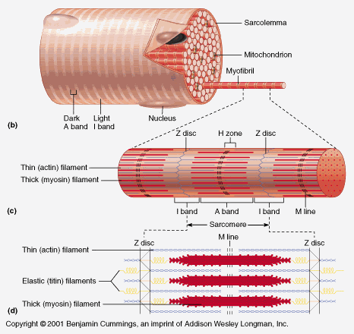

Slide 11
Skeletal Muscle Fibers Cont.
Within Sarcoplasm:
Sarcoplasmic Reticulum (ER)
Network of membranous channels that surround myofibrils
Transverse Tubules:
T-tubules:
Membranous channel that extends inward and passes al the way through to the outside of the fiber. Contains extracellular fluid.
Cisternae:
Region where actin and myosin filaments overlap
SR and T-tubules active muscle contraction mechanism when fiber is stimulated.

Slide 13
Medical Minute
Muscle fibers and their associated connective tissues are flexible but can tear if overstretched. This type of injury, common in athletes, is called a muscle strain. The seriousness of the injury depends on the degree of damage the tissues sustain. A mild strain injures only a few muscle fibers, the fascia remains intact, and loss of function is minimal. In a sever strain however, many muscle fibers as well as the fascia tear, and muscle function may be completely lost. Such a sever strain is painful and produces discoloration and swelling.

Slide 14
Neuromuscular Junction
Motor Neuron:
Stimulate muscle fibers to contract
Neuromuscular Junction
Connection between the motor neuron and muscle fiber
Motor End Plate:
Specialized portion of muscle fiber membrane
Branches and projects into recesses of the muscle fiber membrane
Neurotransmitters:
Chemical secretion that stimulates muscle fiber to contract

Slide 15
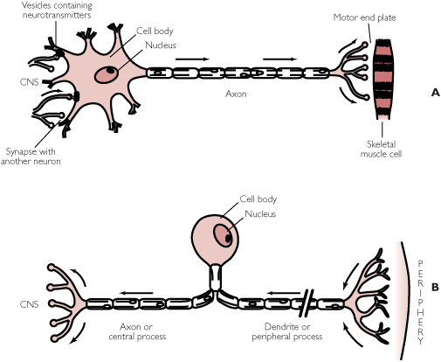

Slide 16
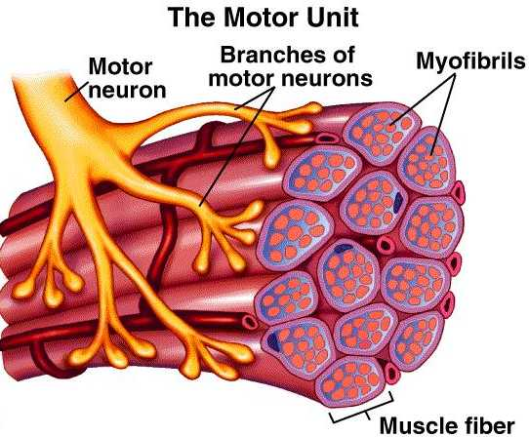
Motor Units
One motor neuron and the muscle fibers associated with it constitute a motor unit

Slide 17
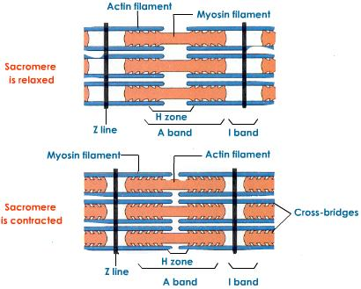
Skeletal Muscle Contraction
Contraction is a complex interaction of cell components and biochemicals
Contraction occurs when actin and myosin slide past one another shortening the muscle fiber and pulling on its attachments.

Slide 18
Role of Actin and Myosin
Globular portions of myosin filaments can form cross-bridges with actin filaments
Sliding Filament Theory:
Calcium ions are present, binding sites on an actin filament are exposed
Cross-bridges on a myosin filament form linkages at the binding sites
A myosin cross-bridge bends slightly, pulling an actin filament, suing energy from ATP
The linkage breaks,
The myosin cross-bridge forms a new linkage with the next binding site

Slide 19
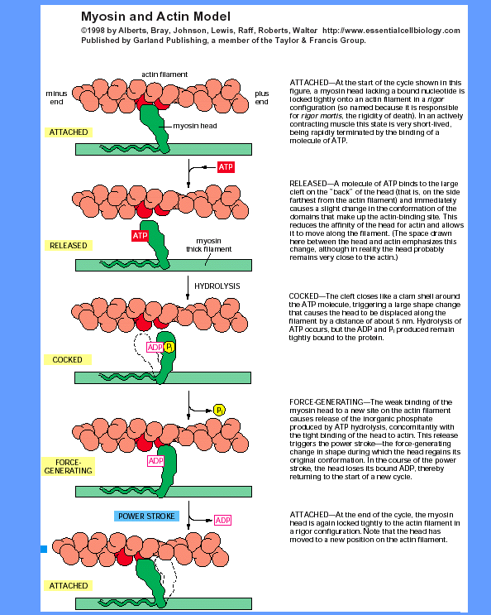
Fig. 8.7 in text
P. 182

Slide 20
Role of Actin and Myosin Cont.
Enzyme ATPase speeds up breakdown of ATP to ADP and phosphate releasing energy.
Energy is needed as a force that causes cross-bridges to pull
Cycle happens over and over as long as ATP is present and the muscle fiber is being stimulated to contract.
Sacromere shortens during contraction

Slide 21
Stimulus for Contraction
Skeletal muscle usually won’t contract without a neurotransmitter stimulating it
Acetylcholine
Stimulant that is stored in vesicles at distal ends of motor neuron
Diffuses rapidly across the synaptic cleft and combines with certain protein molecules (receptors) stimulating a muscle impulse
Travels through T-tubules until it reaches sacroplasmic reticulum

Slide 22
Stimulus for Contraction Cont.
Sarcoplasmic reticulum contains high concentrations of calcium which causes those ions to diffuse into the sarcoplasm.
When sarcoplasm has high concentration of calcium ions they form linkages with actin and myosin filaments and muscle contracts.

Slide 23
Stimulus for Contraction
Two events lead to Relaxation:
1. Acetylcholine rapidly decomposes by enzyme acetylcholinesterase.
Acety……. Prevents a single nerve impulse from continuously stimulating a muscle fiber
2. Acetylcholine breaks down causing stimulus to fiber to cease. As a result, calcium ions are transported back into sarcoplasmic reticulum decreasing calcium concentration which causes linkage to break consequently causing muscle to relax.

Slide 24
Medical Minute
The bacterium Clostridium botulinum produces a poison, called botulinum toxin, that can prevent the release of acetylcholine from motor nerve fibers at neuromuscular junctions, causing a very serious form of food poisoning called botulism. This condition is most likely to result from eating home-processed food that has not been heated enough to kill bacteria in it or to inactivate the toxin. Botulinum toxin blocks stimulation of muscle fibers, paralyzing muscles, including those responsible for breathing. Without prompt medical treatment, the fatality rate for botulism is high.

